Slide 1
Dr. Harry Gray
Electron Transport in Solar & Fuel Cells

Slide 2

Electron Transport
Predict what electron transport means...
_

Slide 3
Electron Transport - definition
Electron Transport - the study of electrons moving from one substance to another. ET is often used as an abbreviation for Electron Transport

Slide 4
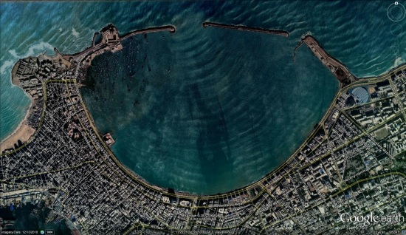
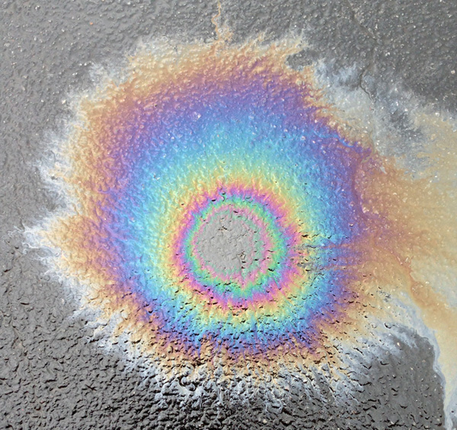
Light - Wave Behaviors
Light has some properties that are wave-like.
Examples include:
how it bends around barriers
how it can produce interference patterns like the rainbow of colors we see in puddles of water on the street that may contain small amounts of oil).

Slide 5
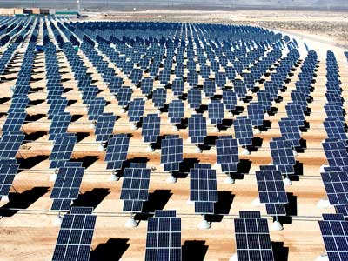
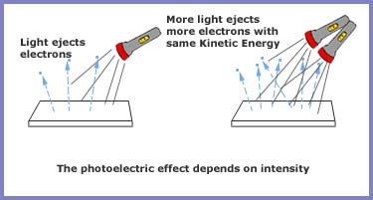
Light - Particle Behaviors
Light has some properties that are particle-like.
Examples include:
  Many things we use, but don’t realize demonstrate particle behaviors.
  Solar Cells
  Light Sensors (to turn lights on and off, to prevent your garage door from closing on children)
Note: When we turn dim the lights,
we send fewer particles of light.
These light particles are called photons.

Slide 6
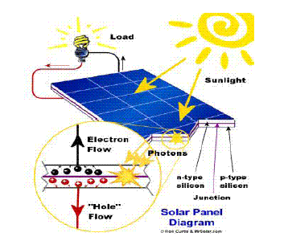
Solar Cells & ET
A photon hits a solar cell.
The photon knocks an electron off of an atom.
There now exists a free electron and a space that would like an electron (an electron hole).

Slide 7
Solar Cells & ET
The electron and the electron hole move to opposite side of the solar cell. This is done with some carefully designed structure to the silicon within the solar cell.
The electron travels across an external wire to meet the electron hole at the other side of the solar cell.
A light bulb, motor, or other device can be connected to the external wire.
A more complete description is at:
http://www.pveducation.org/pvcdrom/solar-cell-operation/light-generated-current

Slide 8

Solar Cells & ET
Dr. Gray’s work in electron transport relates to how the electrons and the electron holes move throughout the solar cells.

Slide 9
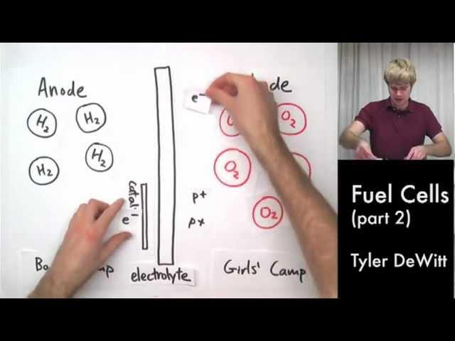
Fuel Cells & ET
Tyler DeWitt uses a sometimes uncomfortable analogy to boys & girls summer camps. It can be awkward, but it is pretty complete.

Slide 10
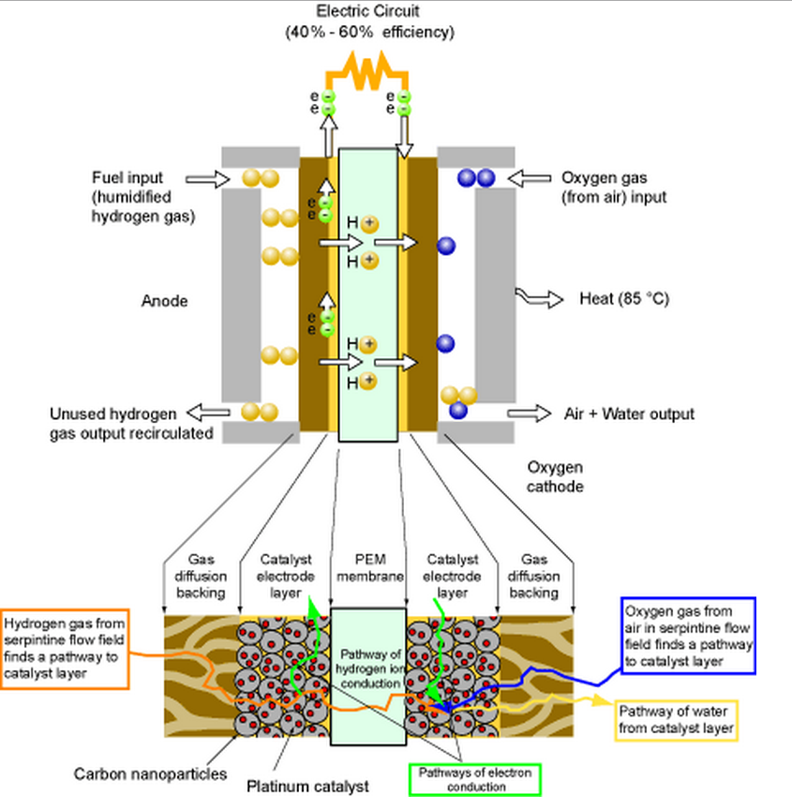
Electron Transport
Dr. Harry Gray’s work in electron transport is applicable to how fuel cells function.
Image from:
http://physics.nist.gov/MajResFac/NIF/Images/FuelCellBasic.gif

